Slide 1
Advanced pcb lab
Marvin the hackbut
By Ben De Lathouwer

Slide 2
Secondary micro controller
Purpose
Generating motor driver pwm
Controlling motordriver
Controlling hc-sr04
sending data to the main microcontroller

Slide 3
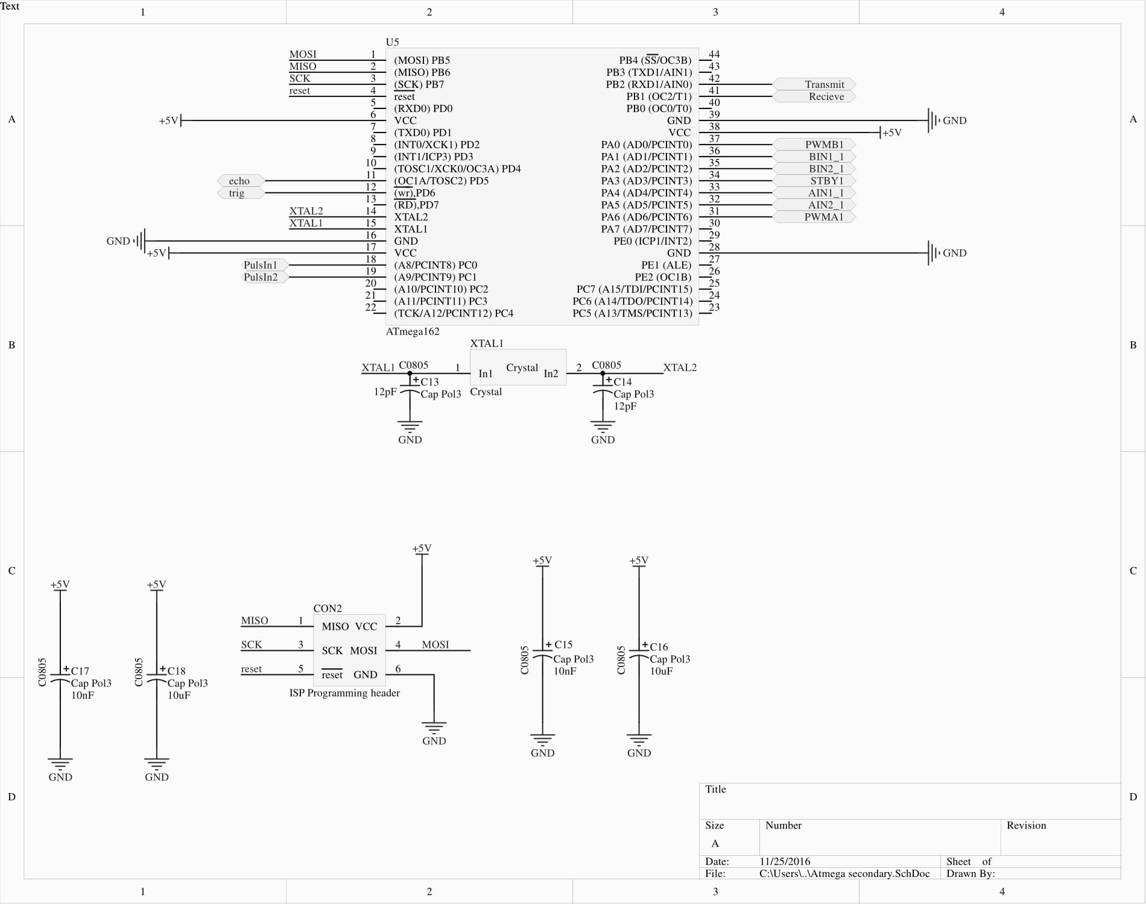
Secondary micro controller

Slide 4
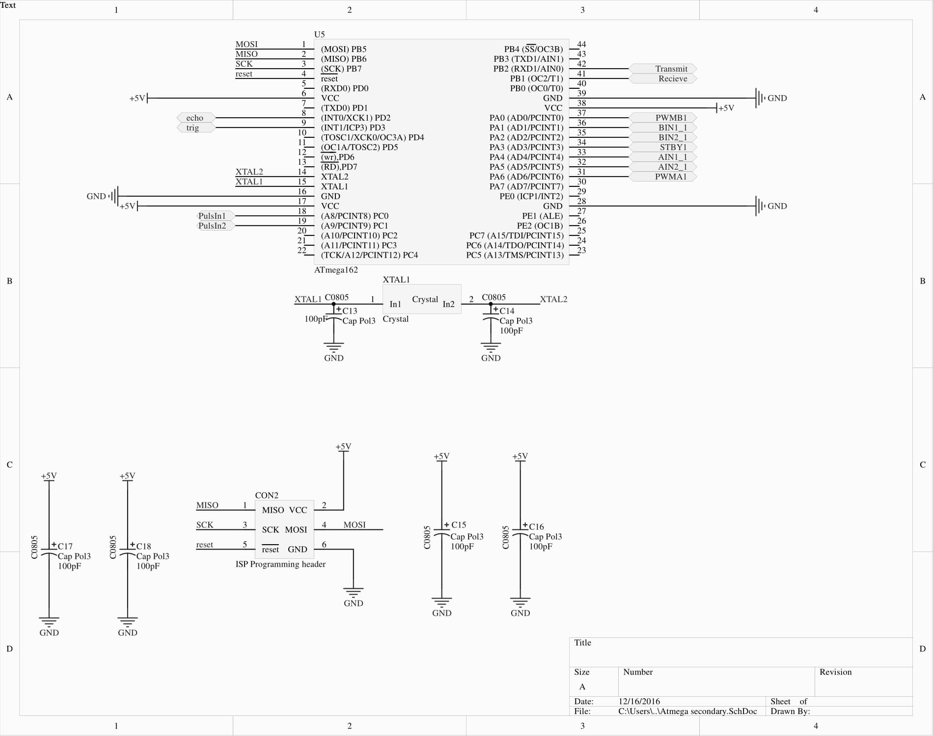
Secondary micro controller

Slide 5
Main micro controller
Purpose
Generating data for esp8266
Controlling levelshifter
Controlling hc-sr04
receiving data from the secondary controller

Slide 6
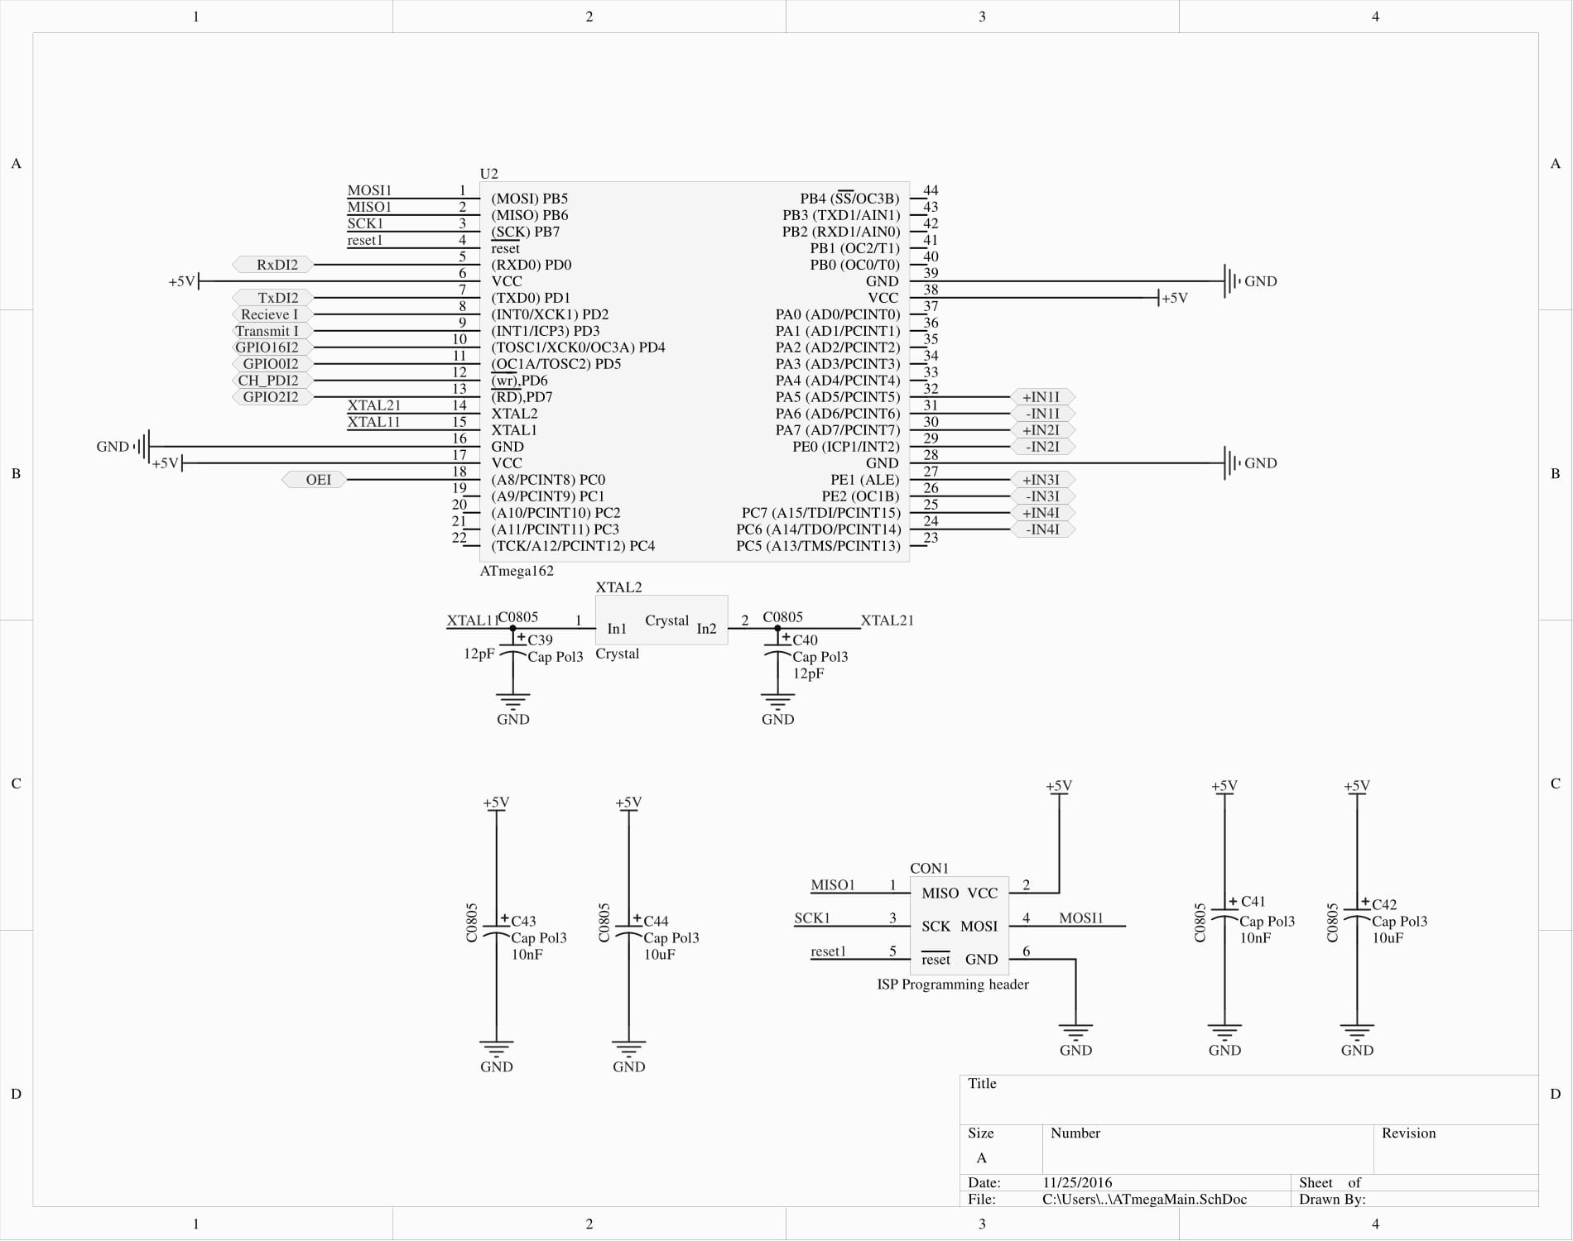
Main micro controller

Slide 7
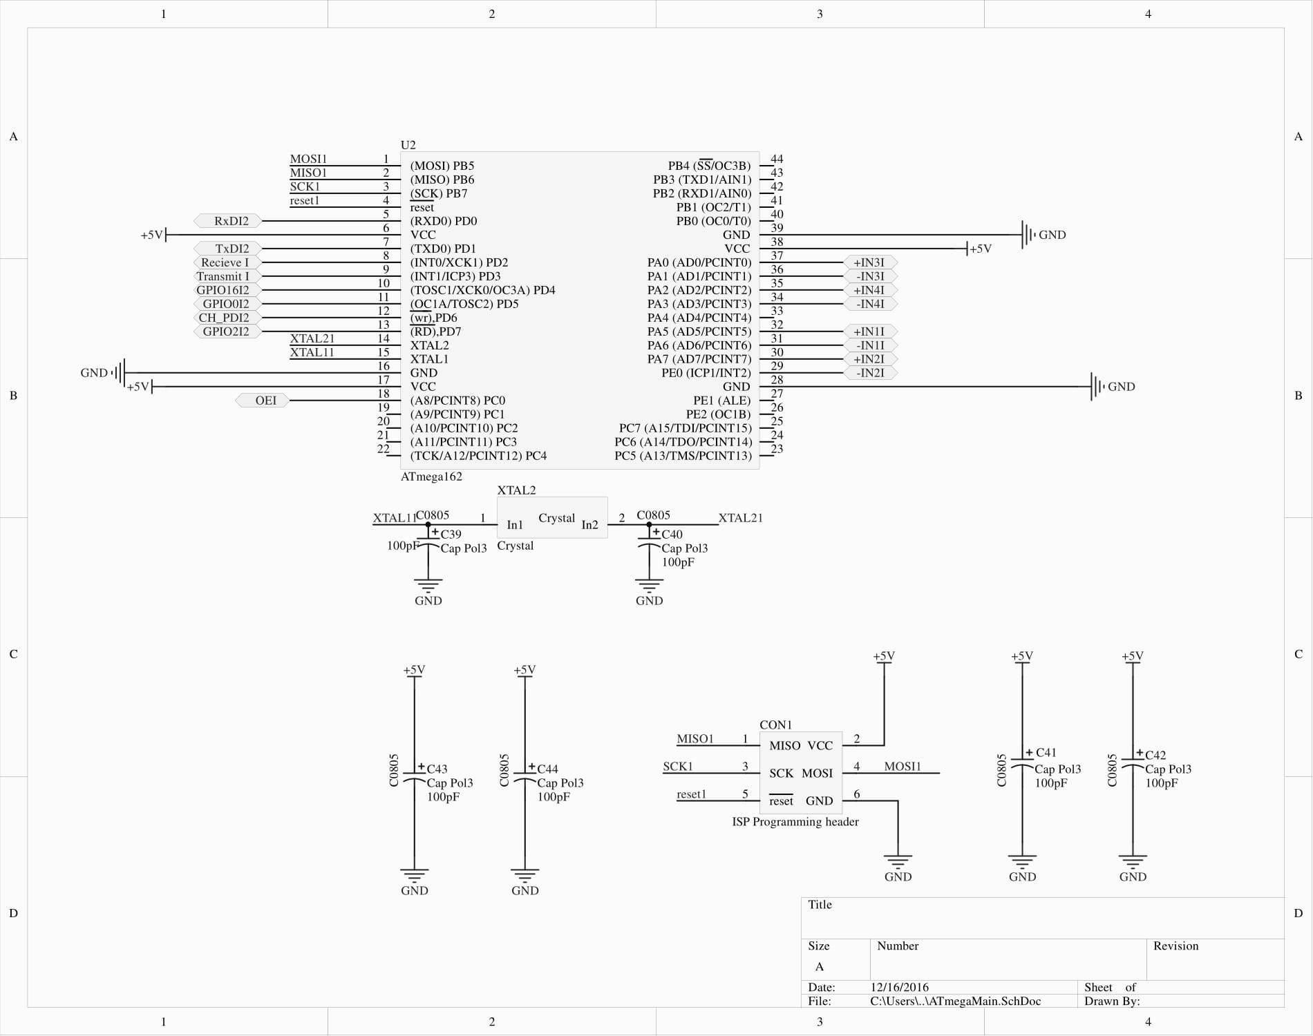
Main micro controller

Slide 8
Why to microcontrollers?
Taking load of the controller(interrupt wise)
Relatively more i/o available

Slide 9
Encoders
Rover chassis=> quadrature encoders
Number of sensors can be used
Optical(IR pair) => whit black and withe surfaces
Magnetical(hal sensor) => magnet on a shaft
Pulses 90degrees out of phase

Slide 10
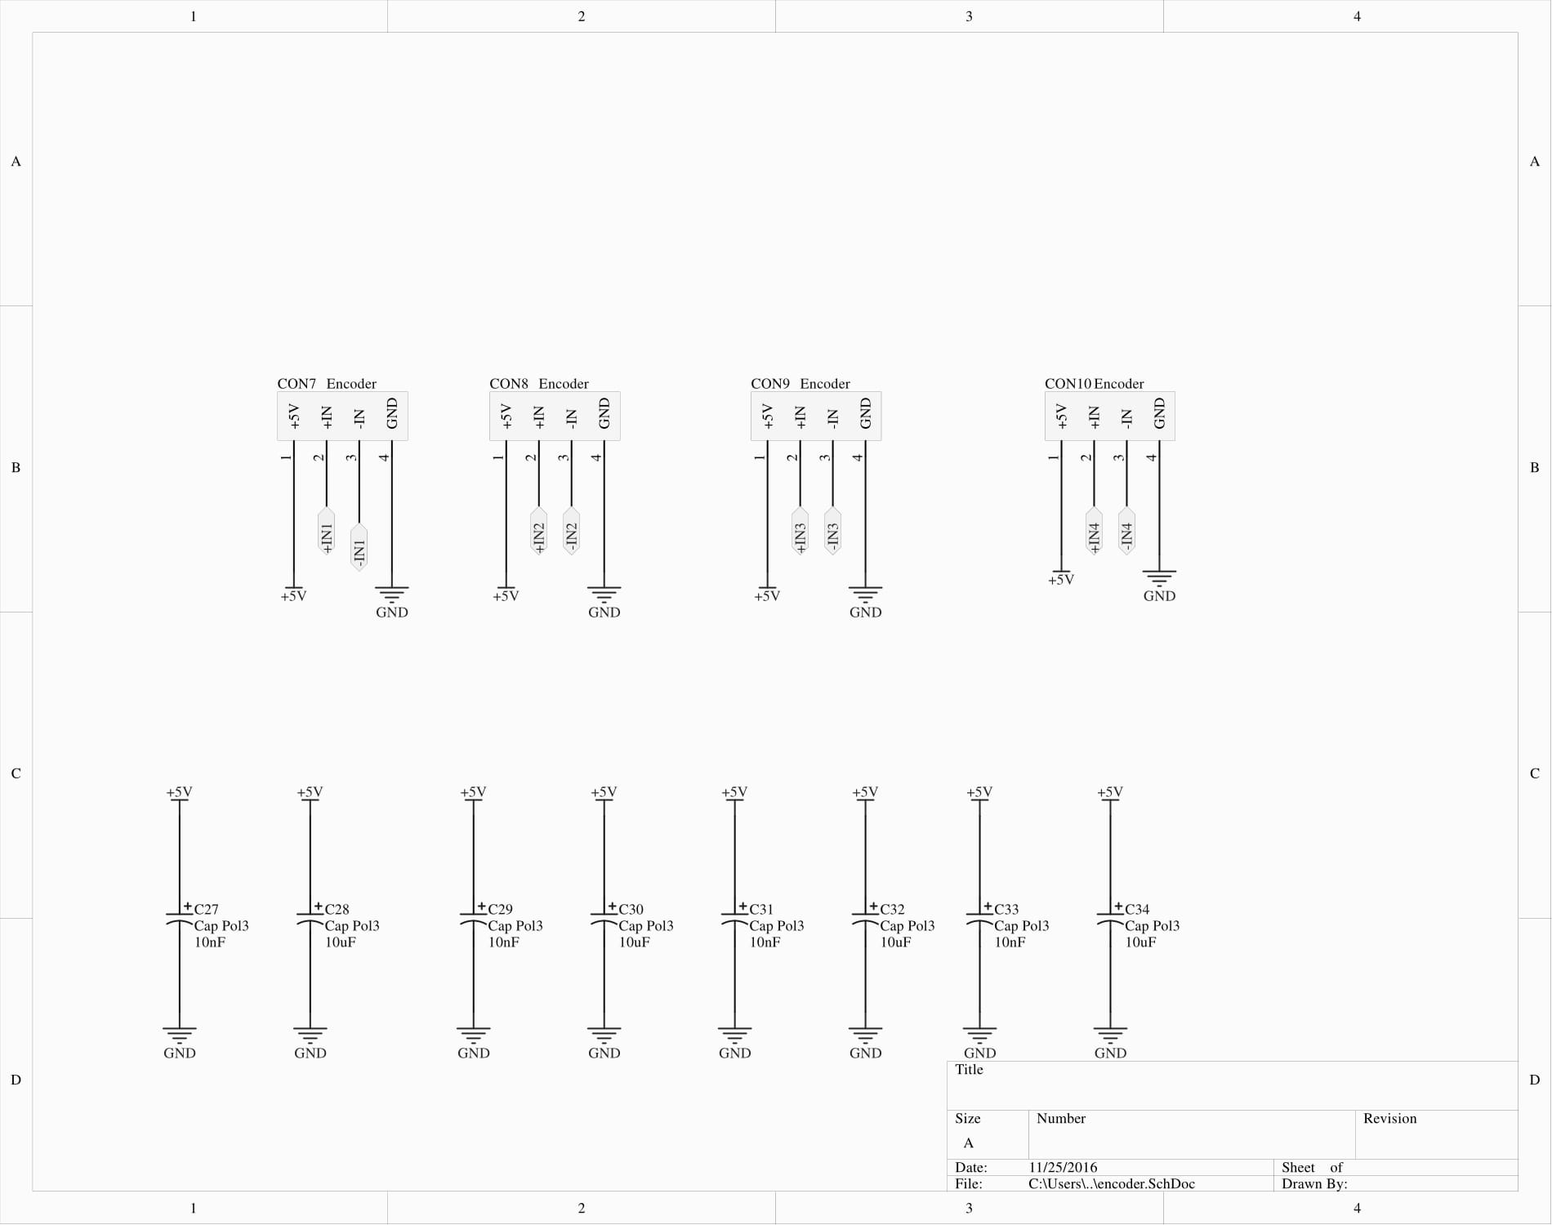
Encoders

Slide 11
ESP8266
Cheap wifi module (6 euro’s)
with onboard System On chip
Communicating protocol=> AT commands via serial port
No components under the antenna!
3.3V ONLY!!! No 5V tolerant I/O

Slide 12
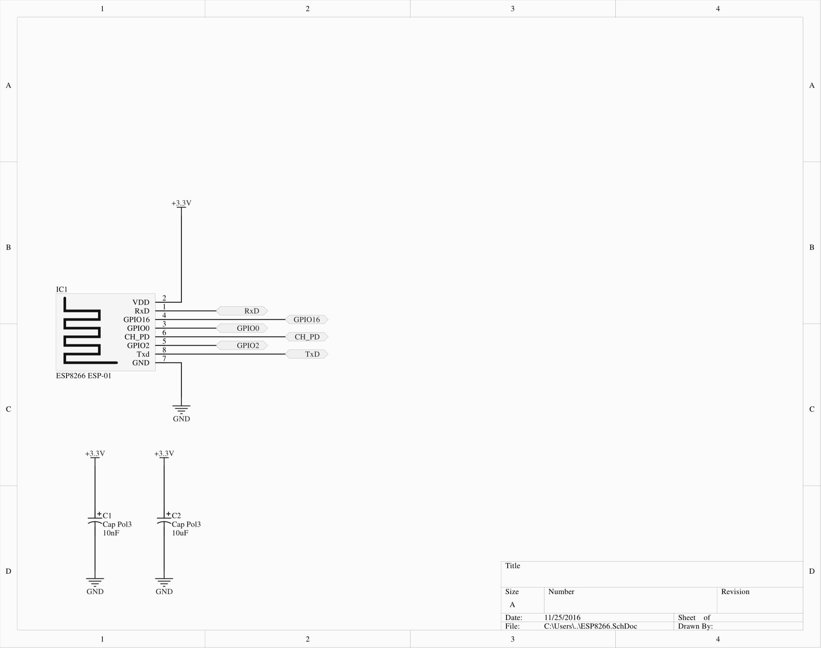
ESP8266

Slide 13
Level shifter
Converts signal other voltage level
For example 3.3V to 5V
TXB0108 uses 2 voltage supply’s
Vcca => 1.2V to 3.6V
Vccb =>1.65V to 5.5V
Needs to be used because of the esp8266
Level shifter needs to be enabled via OE pin

Slide 14
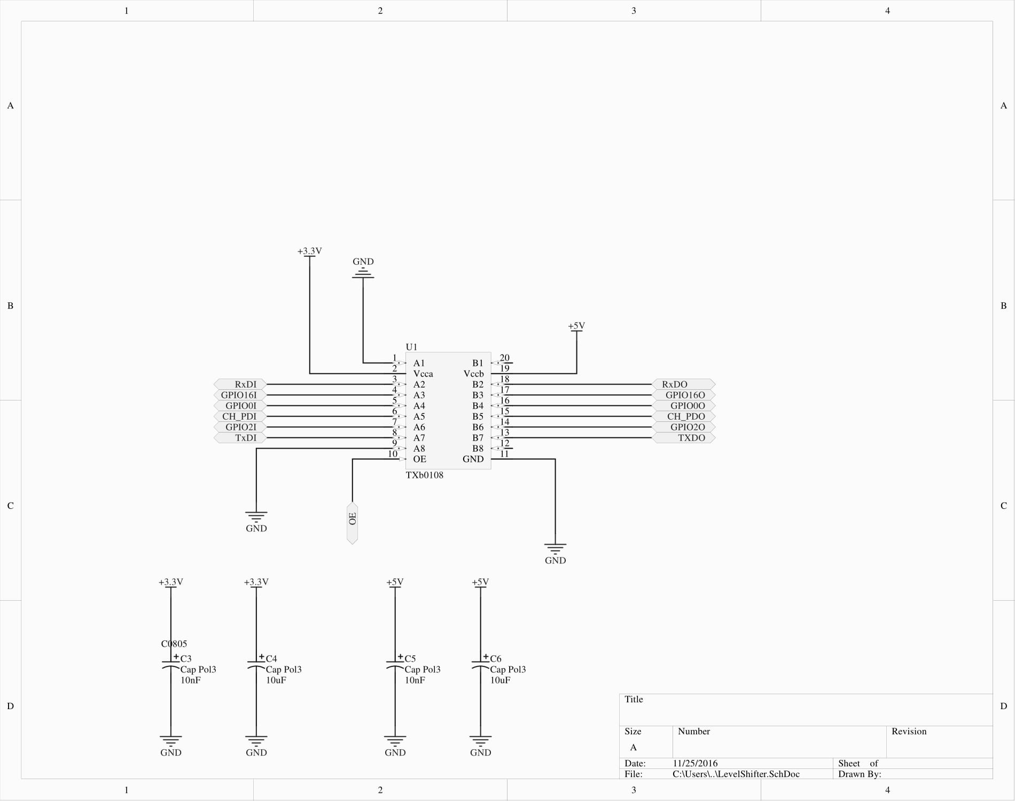
Level shifter

Slide 15
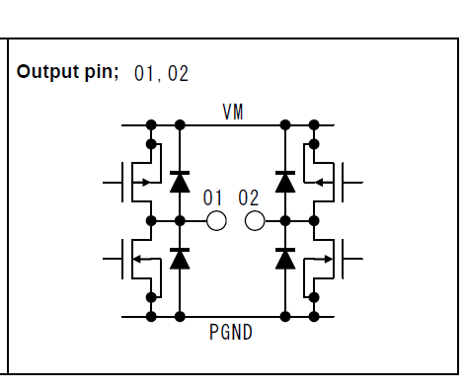
Motor driver
Using h-bridge
TB6612FNG
Integrated H-bridge with integrated control circuit’
No need to worry about short circuiting the internal mosfets
Iout 1.2A Max with peak current up to 3.2A

Slide 16
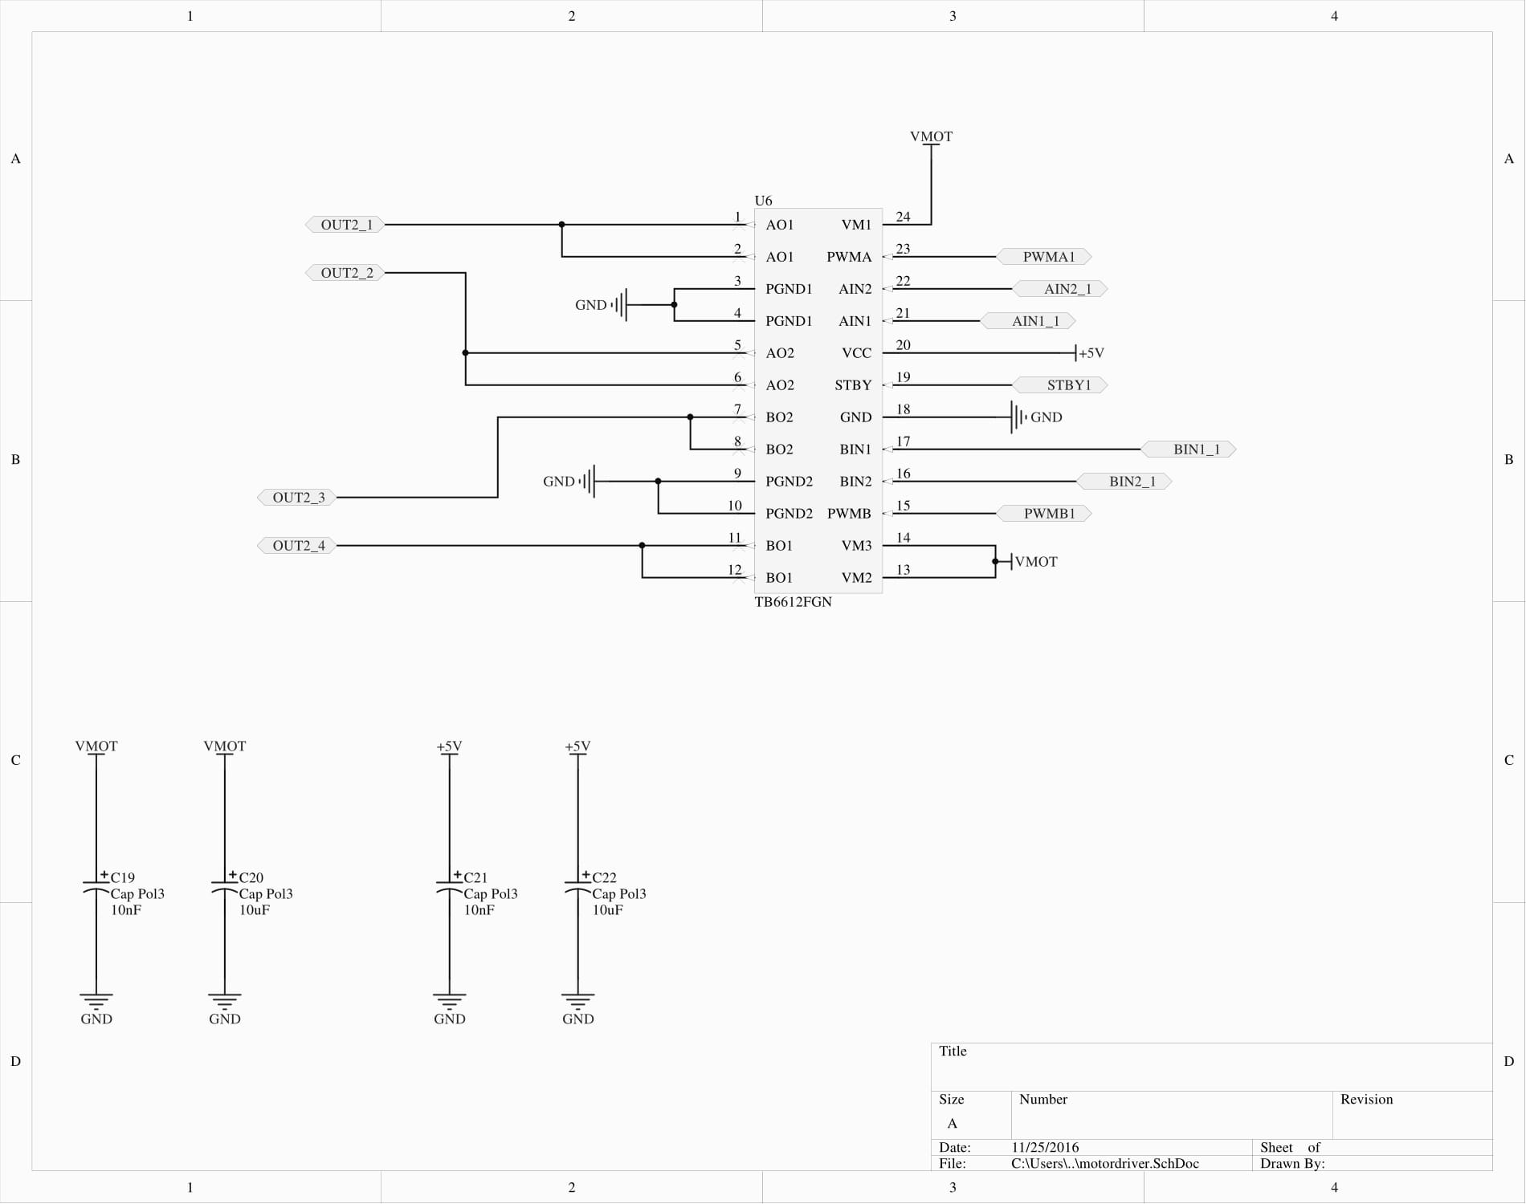
Motor driver

Slide 17
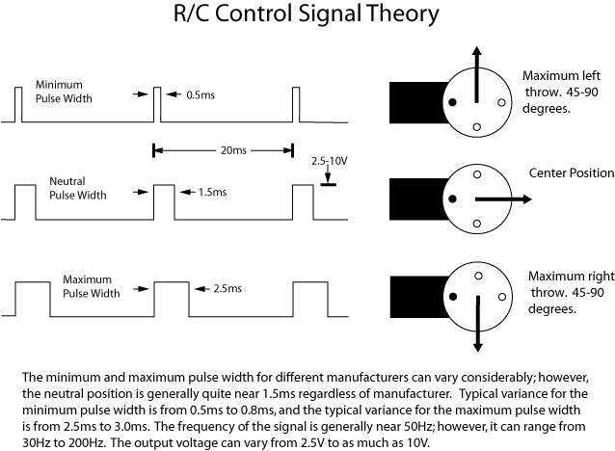
Rc reciever
Standart modelling rc receiver
Servo output
Wirles communication
Gets transformd into
Pwm signal

Slide 18
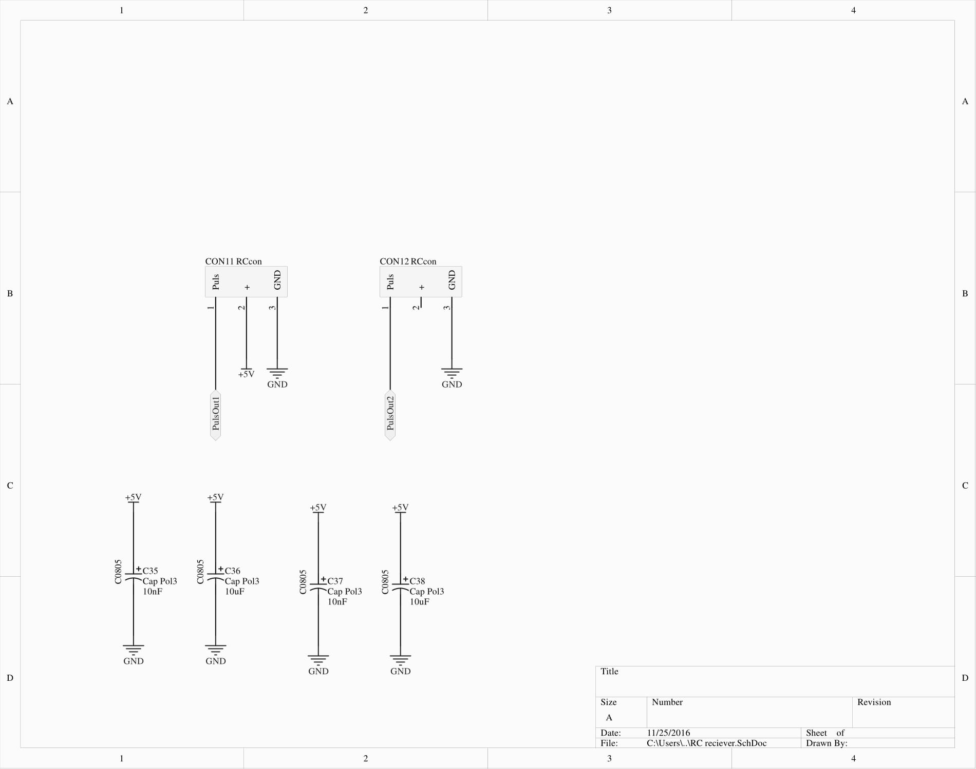
Rc reciever

Slide 19
Ultrasonic distance sensor
Measurement using sound
4 pins
Gnd, vcc triger input and echo output
Echo puls with proportional to distance
distance = high level time * velocity (340M/S) / 2
High level= duration of puls with(milli or micro seconds)
velocity = 340M/S

Slide 20
Ultrasonic distance sensor
Ranging distance =cm to meters
Detection angle is 15 degrees

Slide 21
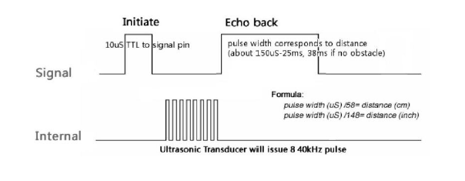
Theoretical signals

Slide 22
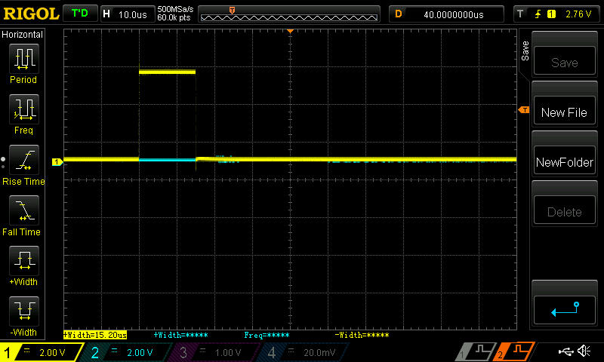
Trigger puls

Slide 23
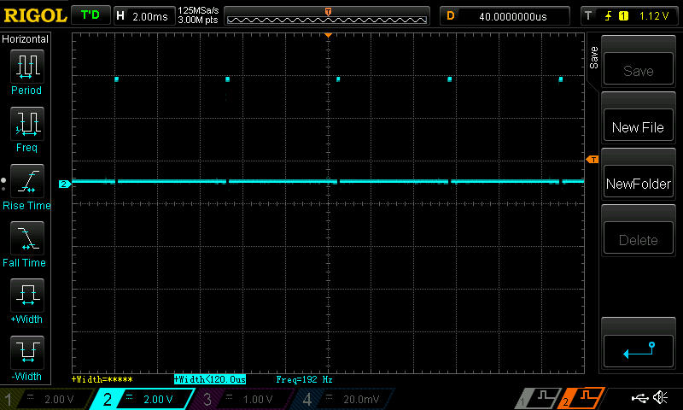
Echo puls minimum distance

Slide 24
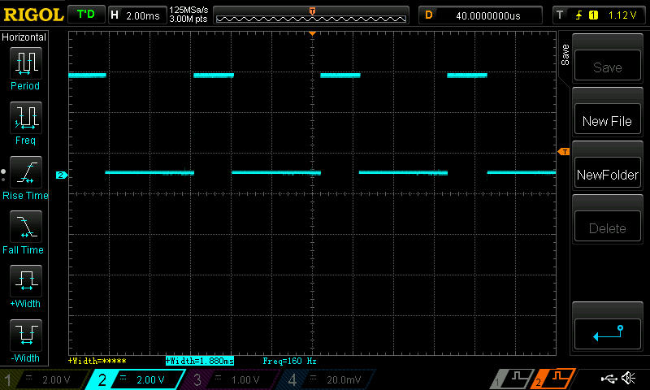
Echo puls max distance

Slide 25
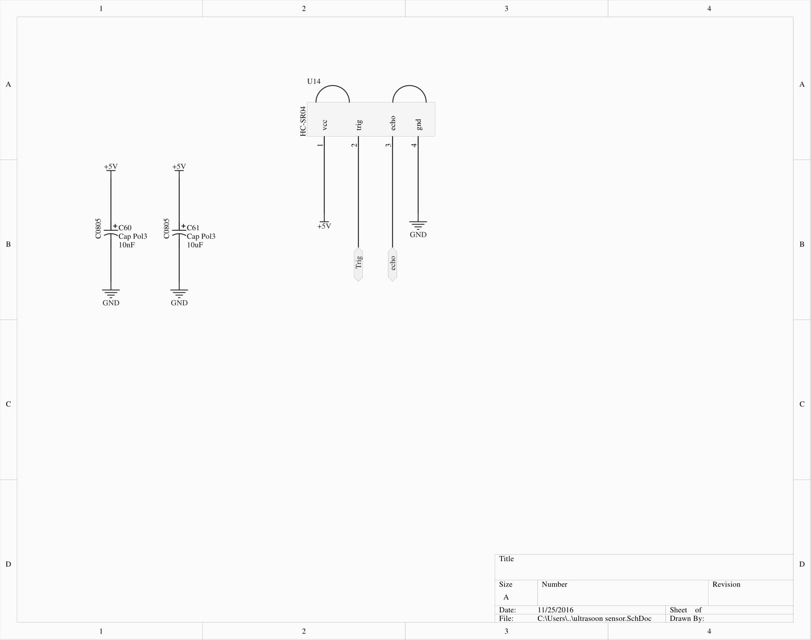
Ultrasonic distance sensor

Slide 26
Power supply
Uses ldo’s
Low dropout voltage
Used to generate 5V and 3.3V for control electronics

Slide 27
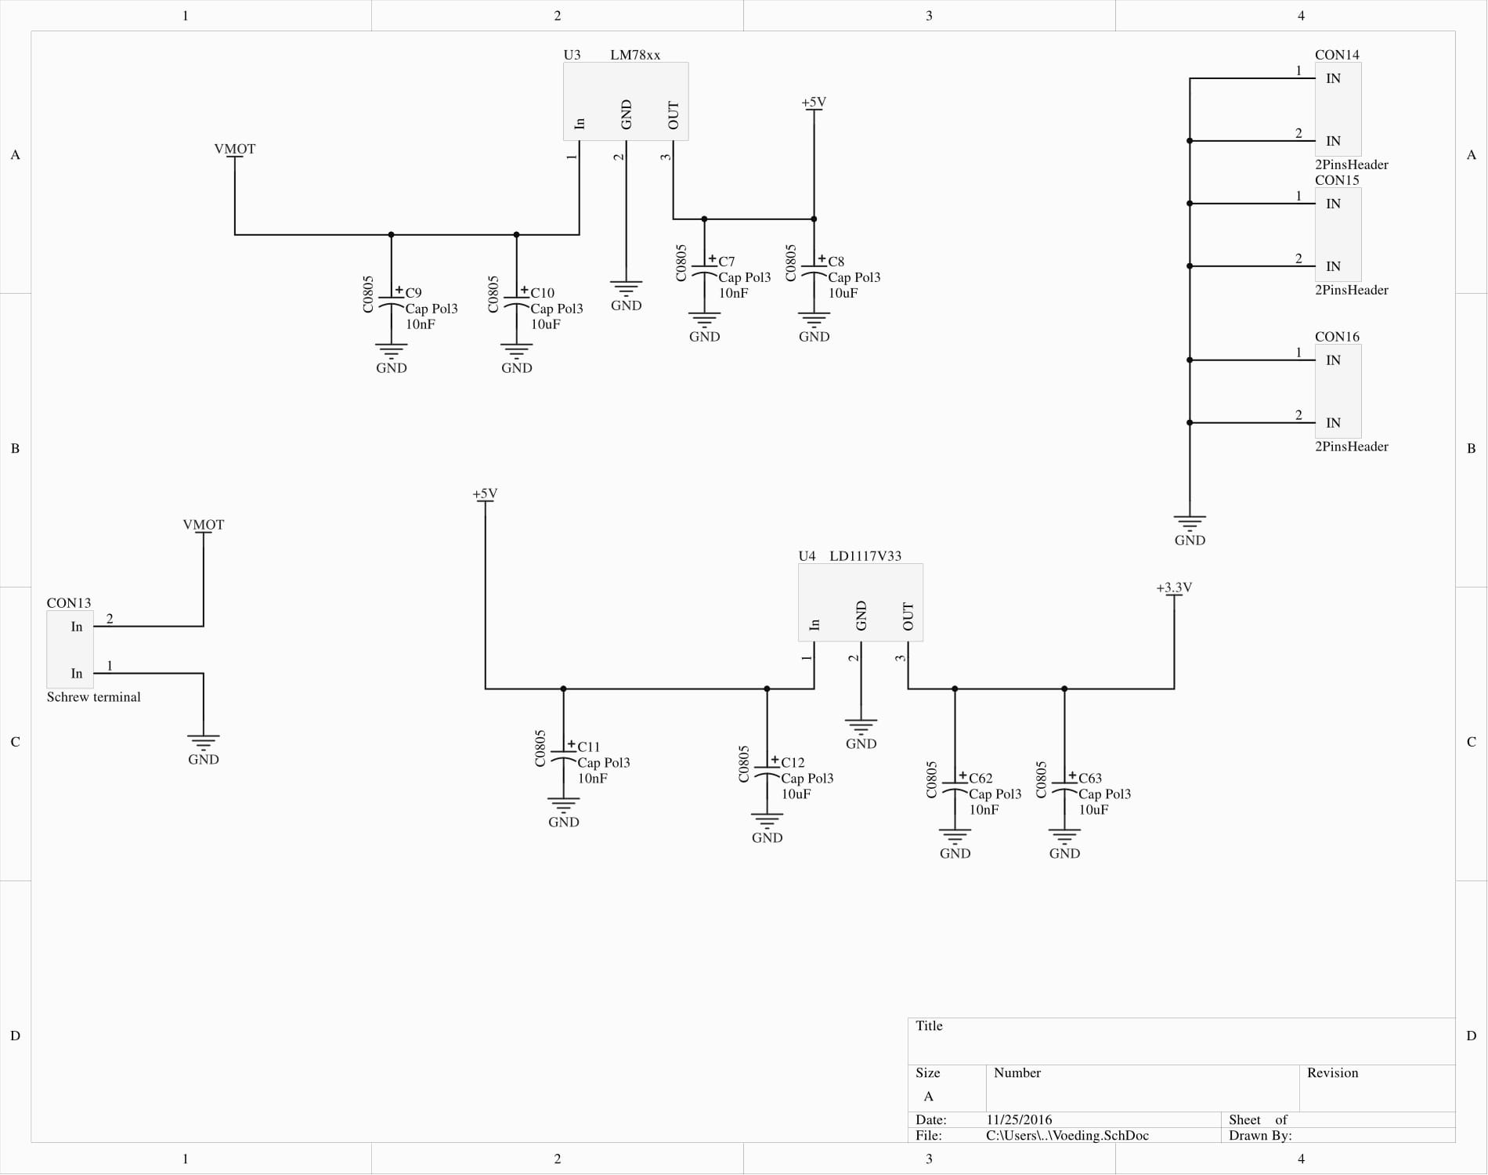
Power supply

Slide 28
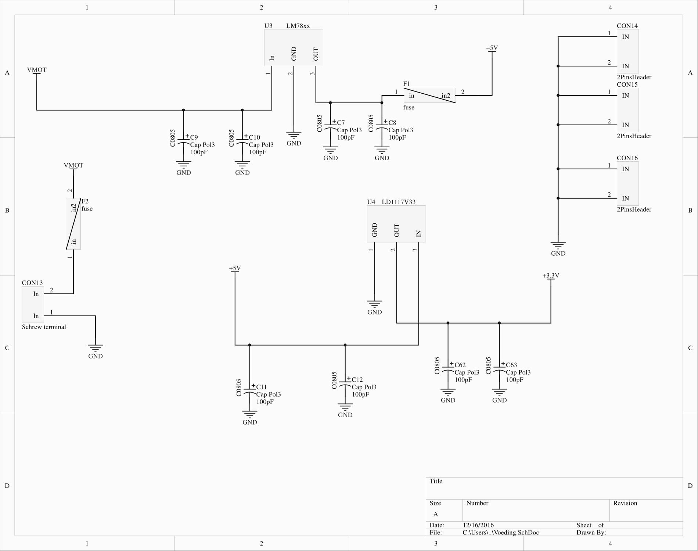
Power supply

Slide 29
What did I learn ?
Circuit design
To think first then design
First reading the datasheet
Then draw footprints etc.
High current design
Using Altium

Slide 30
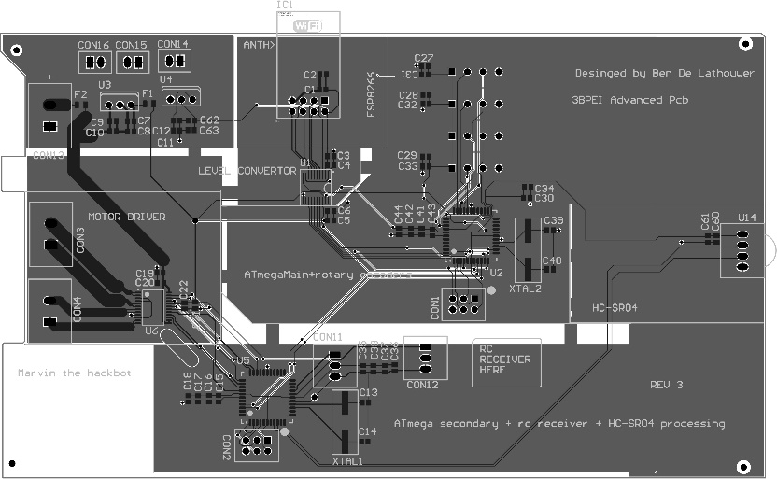
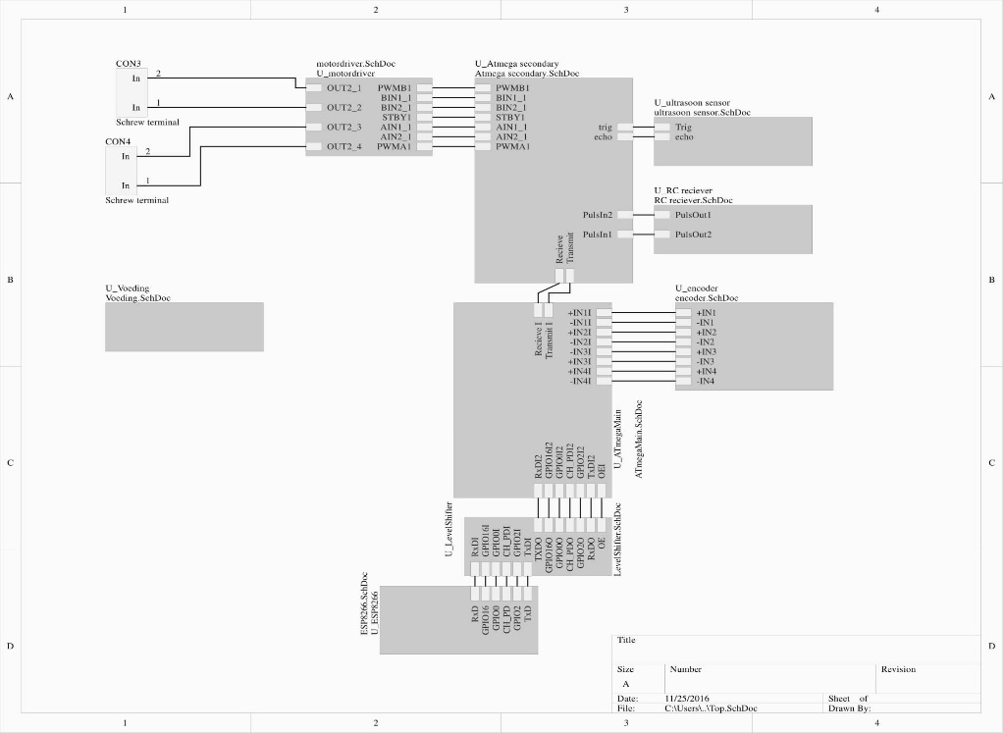
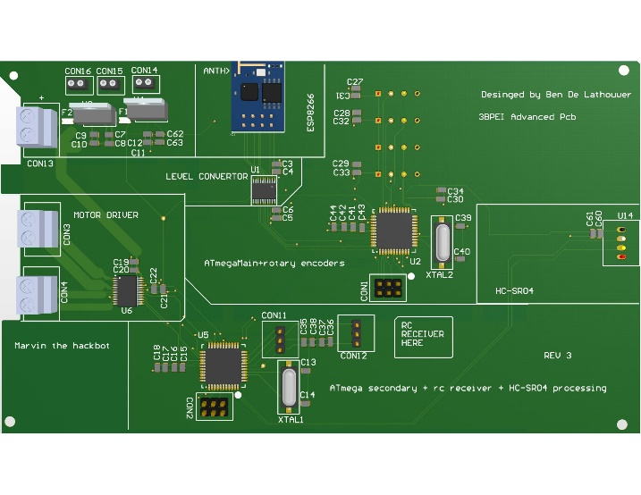
Questions?

